Slide 1

Fligt Booking Online

Slide 2
Professional Programmer Course
Group Members:
Trần Võ Minh
Lâm Ngọc Huy
Mentor: Đỗ Phú Thiện
Notes:
Thank you teacher → group representation

Slide 3
01
02
SYSTEM ANALYSIS
PROJECT INTRODUCTION
03
04
CONCLUSION AND FUTURE EXPANSION
PROJECT DEMO

Slide 4
1. PROJECT INTRODUCTION

Slide 5


1. Project Introduction
Reason why choosing the topic
Project Goals
In the year of 2020, the covid-19 pandamic has affected people life significantly and a large-scale of demands for travelling back to their countries as well as transfering substantial vaccines and supplies to other nations are the major motivationfor us to build this website for people who are in need.
To facilitate the process of flight managements such as saving and deleting flights…
To minimize the difficulties for passengers while booking flights as well as tracking flights’ information…

Slide 6

System Overview
1. Project Introduction
The system is designed mainly towards users who are administrators and passengers.
Ex:
- Administrators can create, edit, delete and view the data related to flights, flight routes, passengers’ information, tickets’ information…
- Passenger can book flights and view ticket details.

Slide 7
2. System Analysis

Slide 8
01
02
03
Ideas and Topics
System Functional Analysis
Database Design
04
System Functional Programming And Complete
2. System Analysis
3/12/2020 – 9/12/2020
10/12/2020 – 15/12/2020
16/12/2020 – 19/12/2020
05
Project Testing and Edit
20/12/2020 – 4/1/2021
5/1/2021 – 8/1/2021

Slide 9









2. System Analysis!
Technologies
Back-end
Spring framework
Database
MySQL Server
Front-end
HTML,Css,Ajax,JS,Bootstrap

Slide 10
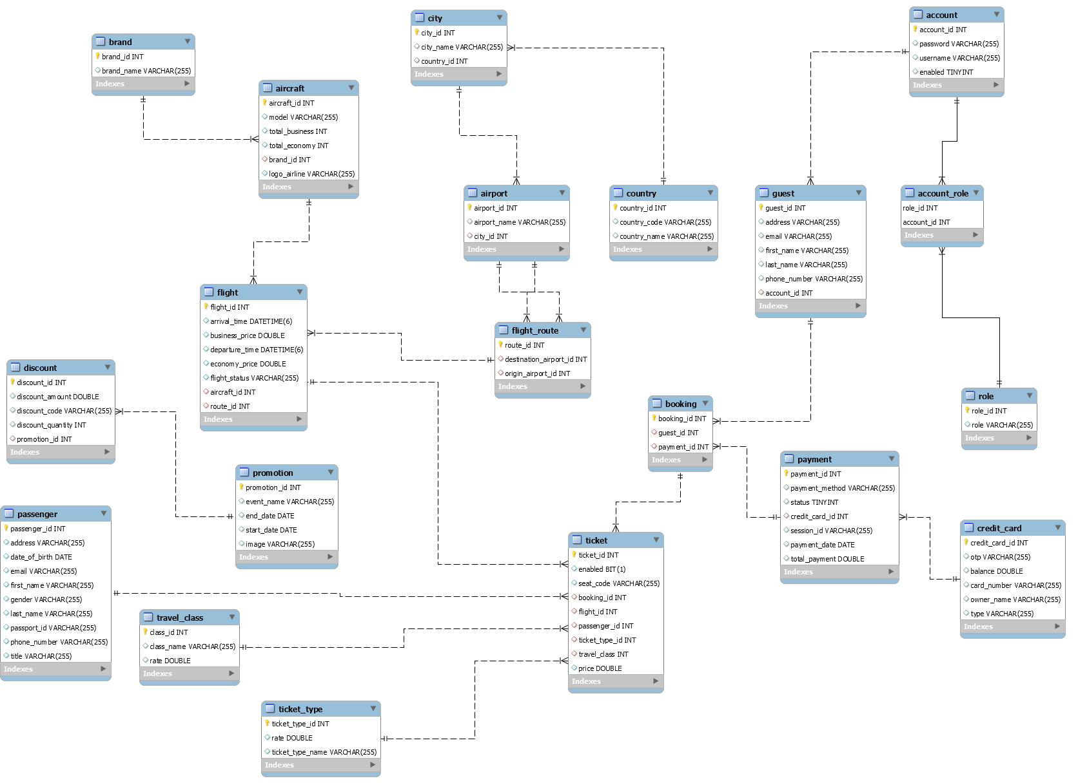
2. System Analysis
ER Diagarm

Slide 11
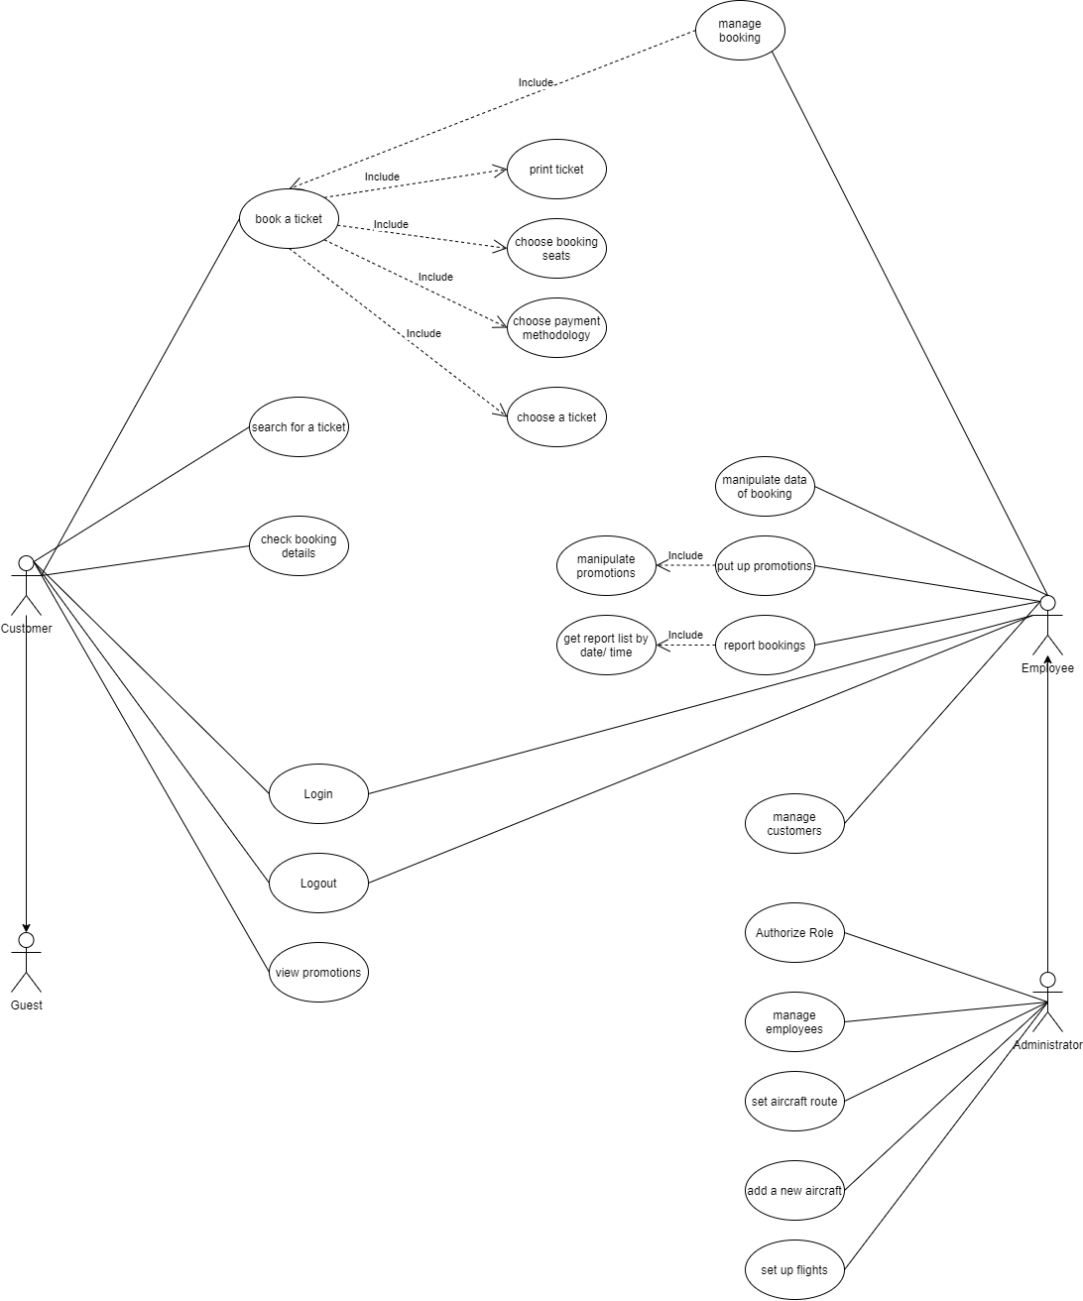
2. System Analysis
Use case Diagram

Slide 12
2. System Analysis
System Function
Login , Register
Search Flight , Seat selection , Booking Ticket
Print Booking Details to PDF , Send Email
Flight Management

Slide 13
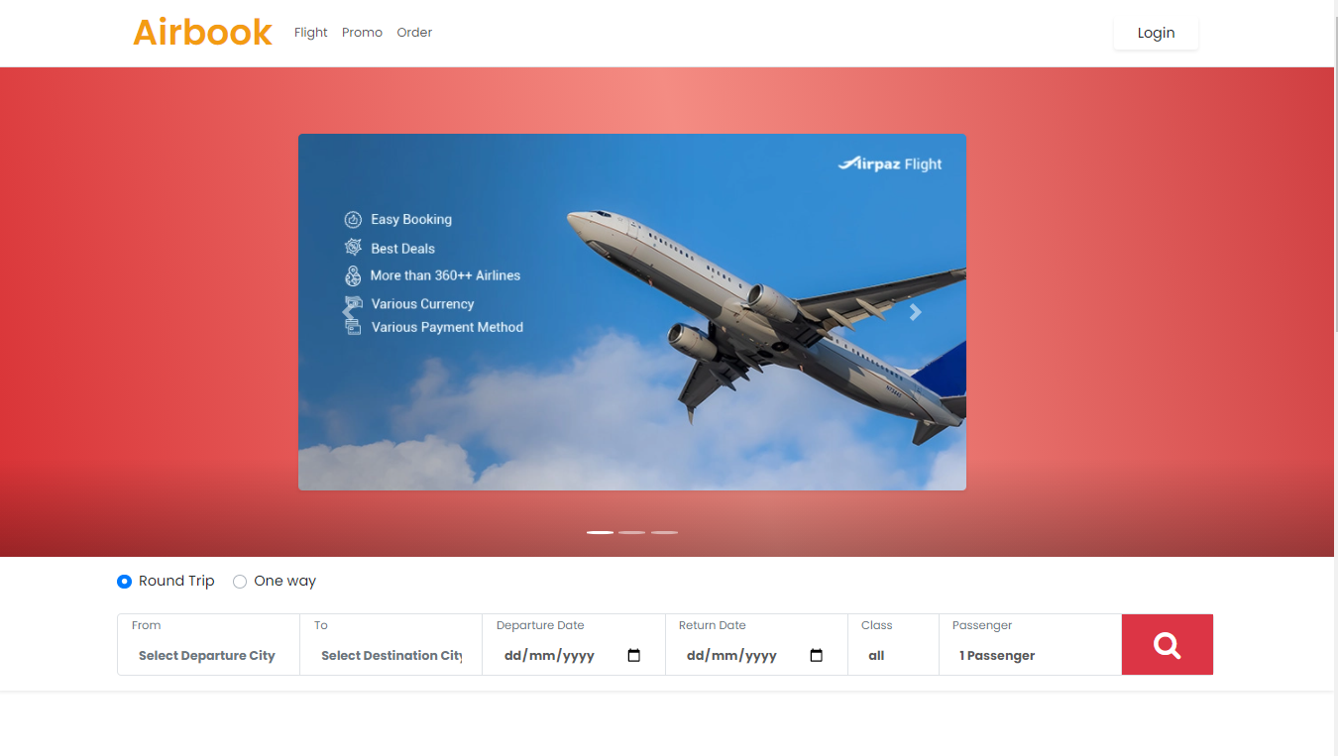
2. System Analysis
Home Page GUI

Slide 14
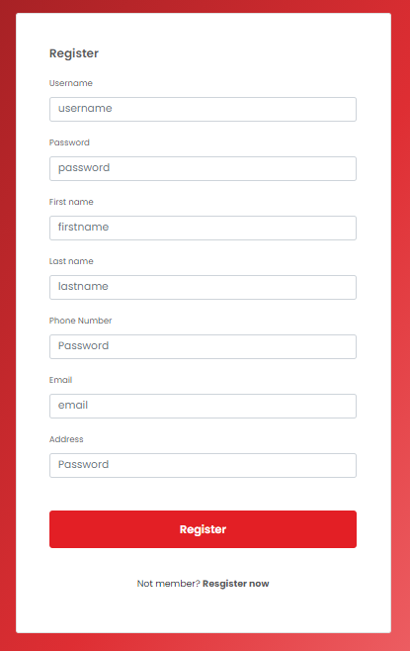
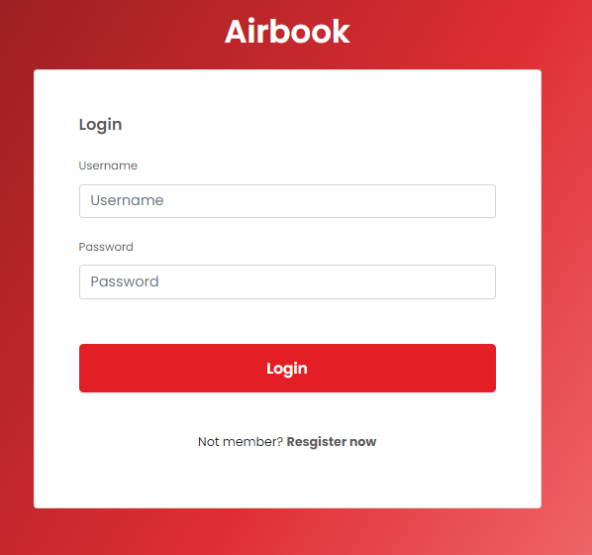
2. System Analysis
Login and Register Functional
Login GUI
Register GUI

Slide 15
2. System Analysis
Searching flights, Booking Tickets and Filling in Passenger Information
This is an in the most important function of the project, customers who want to purchase tickets must follow the following procedure:
Ex: Select origin, destination, date(s), travel class and the number of passenger.

Slide 16
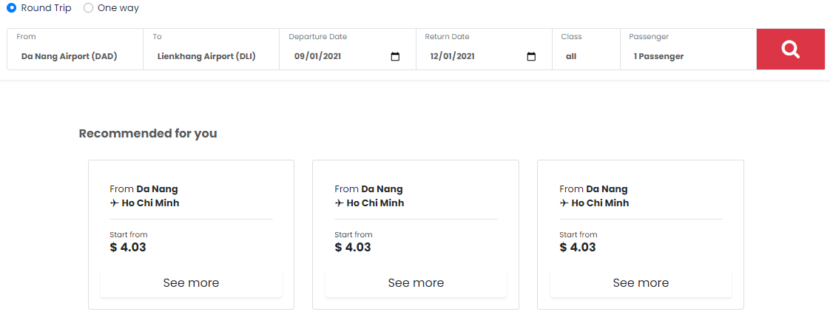
2. System Analysis
Search Flight Function GUI

Slide 17
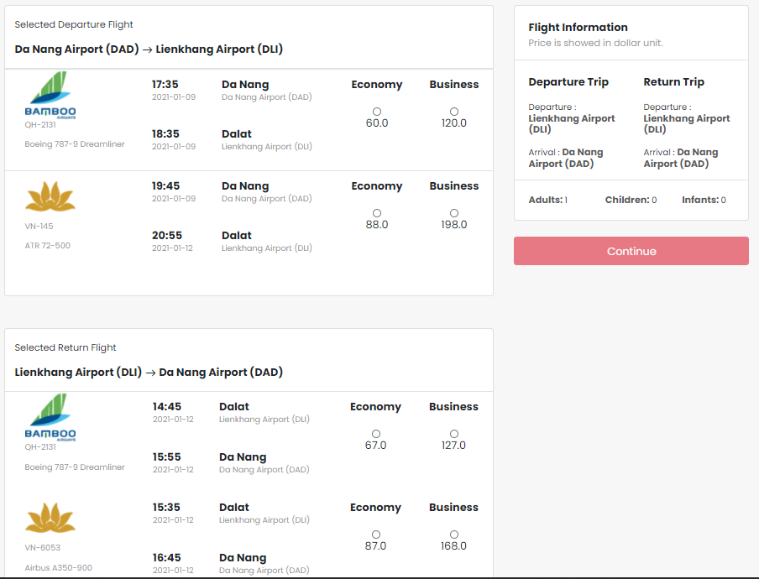
2. System Analysis
Flight Search Results GUI

Slide 18
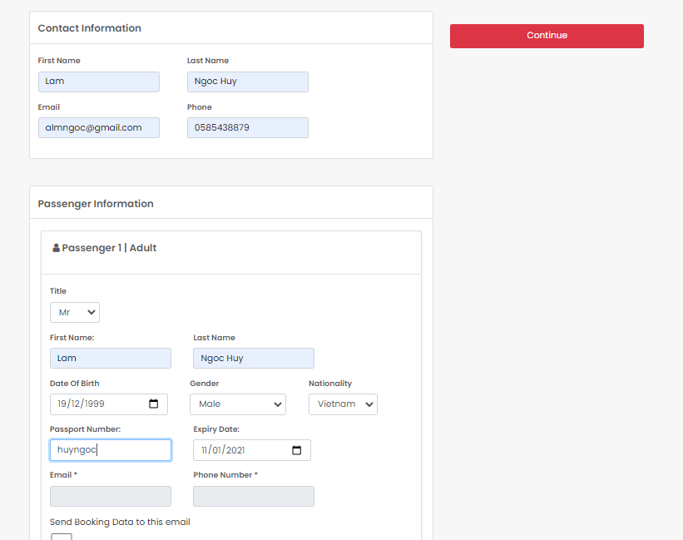
2. System Analysis
Filling Passenger Information GUI

Slide 19
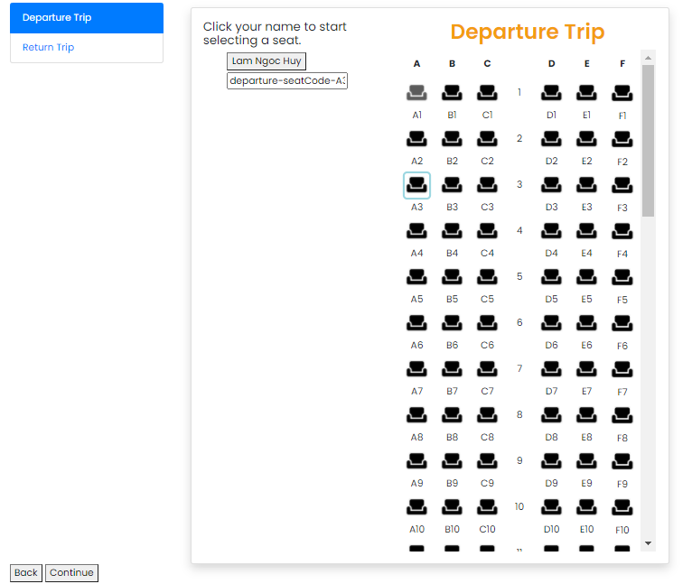
2. System Analysis
Seat selection GUI

Slide 20
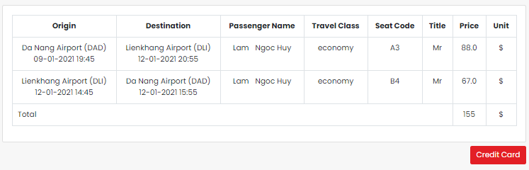
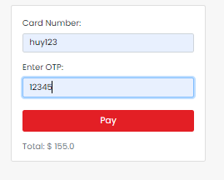
2. System Analysis
Ticket Information And Filling Credit Information GUI

Slide 21
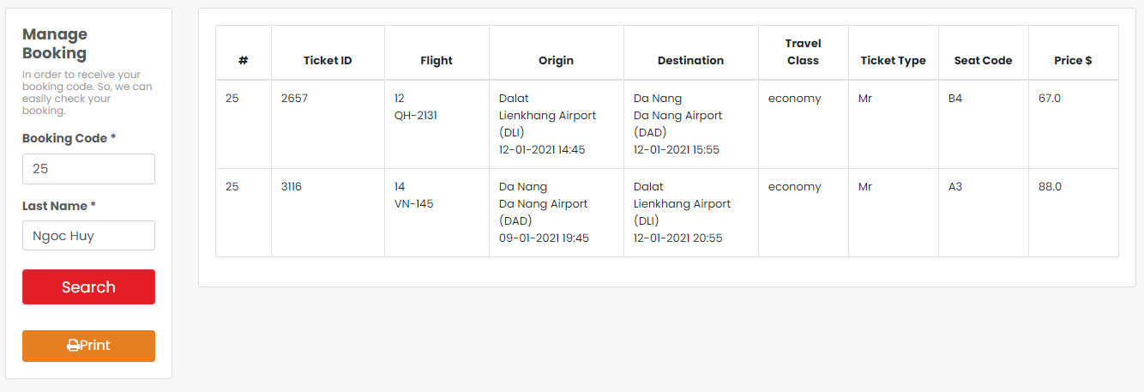
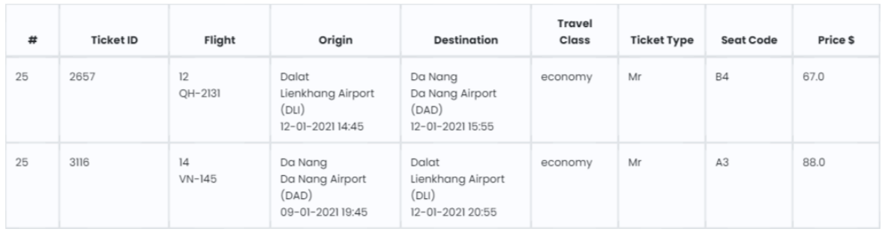
2. System Analysis
Search Booking And Print PDF GUI

Slide 22
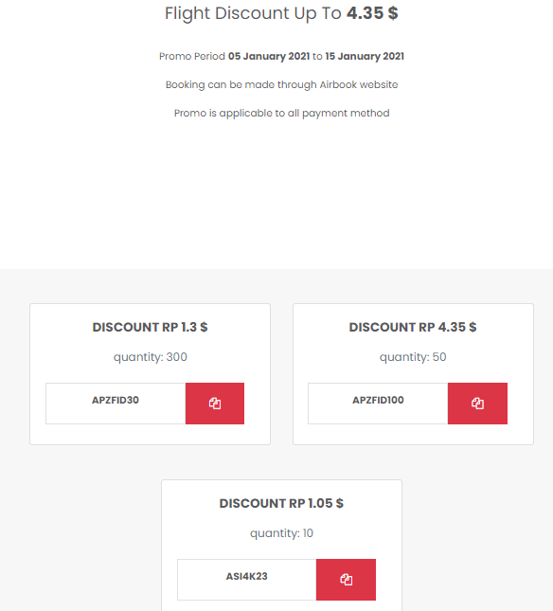
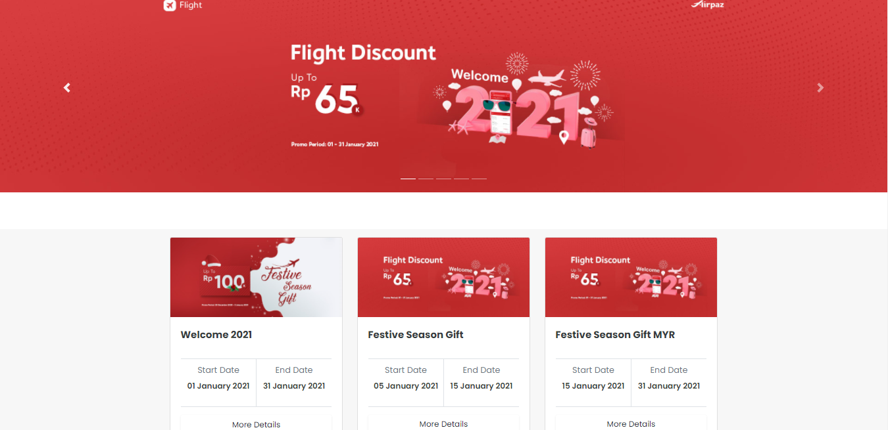
2. System Analysis
Promotion and Promotion Details GUI

Slide 23
1. In general, we have satisfied the most project requirements received from the mentor. 2. We successfully applied the major popular technologies and knowleages learned to our project. 3. We have enhanced our analysis, english and communication skills massively.
3. Conclusion and Future Expansion
Conclusion

Slide 24
3. Conclusion and Future Expansion
Future Expansion
1. Only Allow user to book a tickets in a specific amount of time. 2. Lock seats temporarily to avoid conflict between users while choosing seats. 3. Search with select options when looking for flights. 4. Enhance the user interface more user-friendly. (and more)

Slide 25
4. Project Demo
Do you have any questions ?

Slide 26
THANKS!
Our group would like to give a special and sincere thank to Mr. Đỗ Phú Thiện for his effort to support and guide us during the courses and the final project. Because of that reason, we have a strong foundation and capacity to implement this project and apply for a future job.
Furthermore, we would like to thank IViettech Center who created the opportunities and environments for us to thrive.
Especially we would like to express our gratitude to our family for helping us have adequate conditions to be here.

